Slide 1


Charge Injection System (CIS) Update
Elias Oakes, Mikel Zemborain
The University of Chicago
June 07, 2021

Slide 2
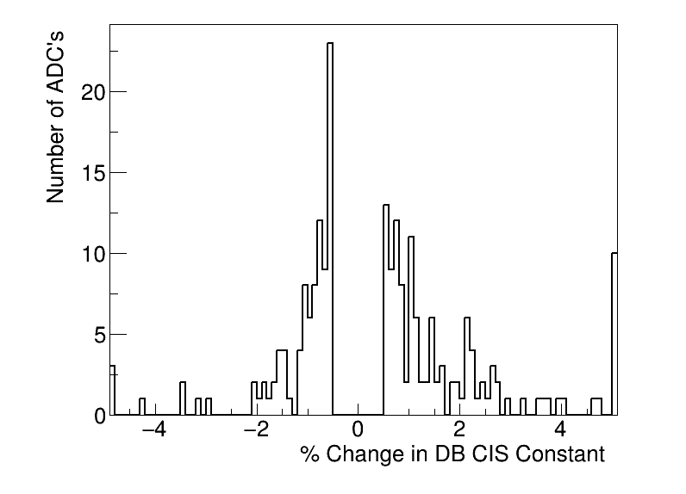
Summary
Updated on June 4
CIS runs from 4/27-6/01
214 ADCs updated
147 good
13 >5% change
10 masked
57 affected

Slide 3
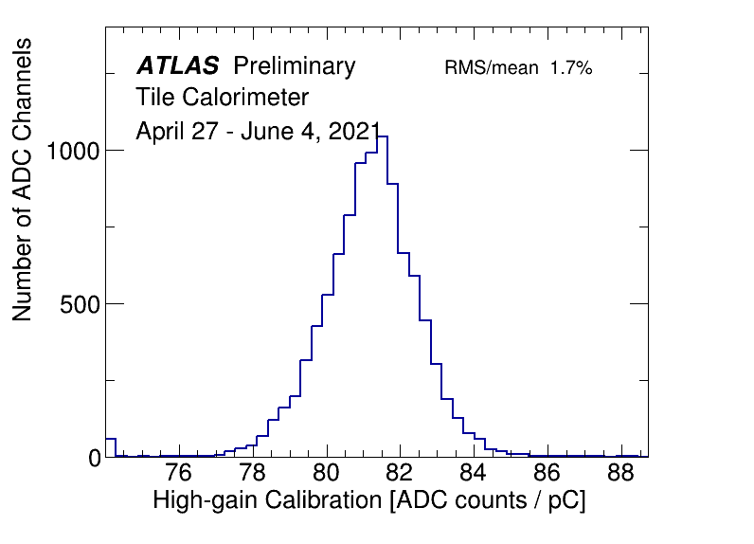
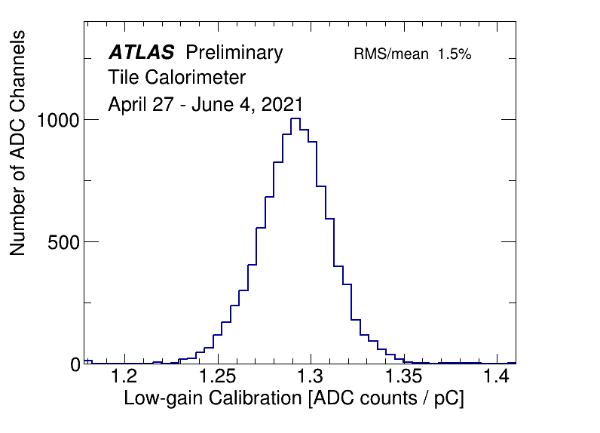
CIS constant distributions

Slide 4
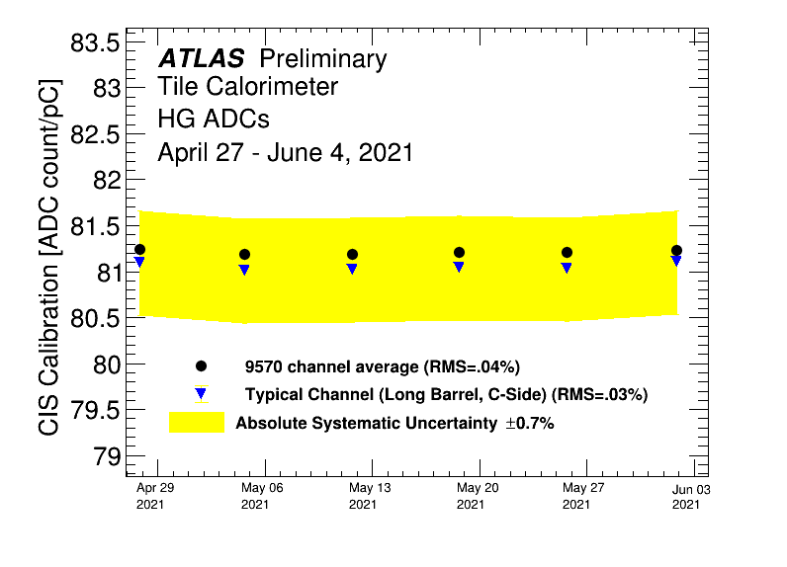
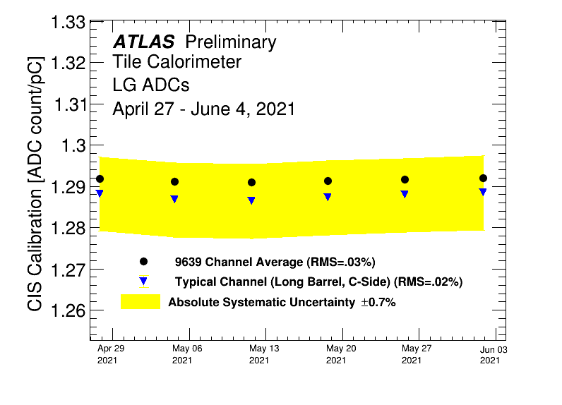
Detector stability

Slide 5
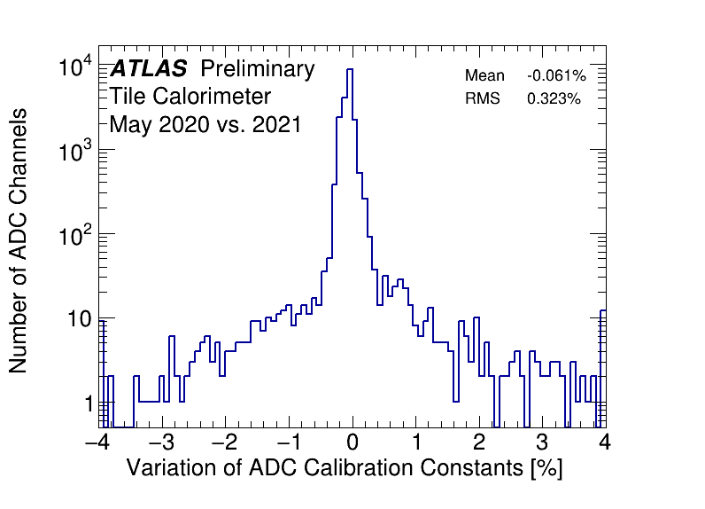
CIS constant stability

Slide 6
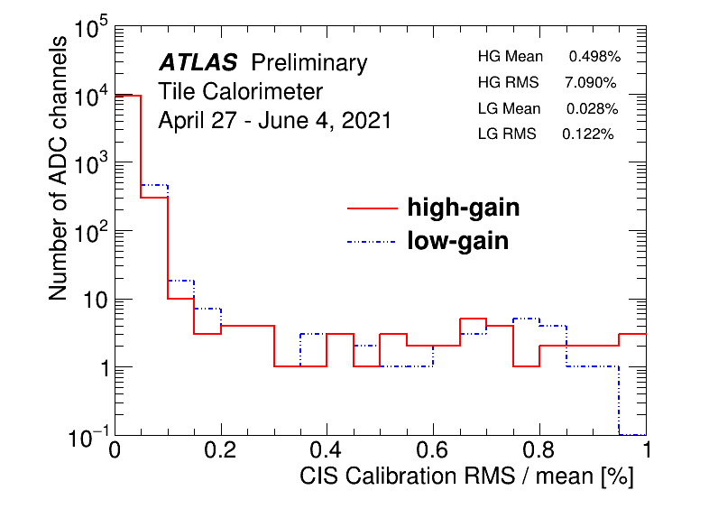
CIS constant RMS/mean

Slide 7
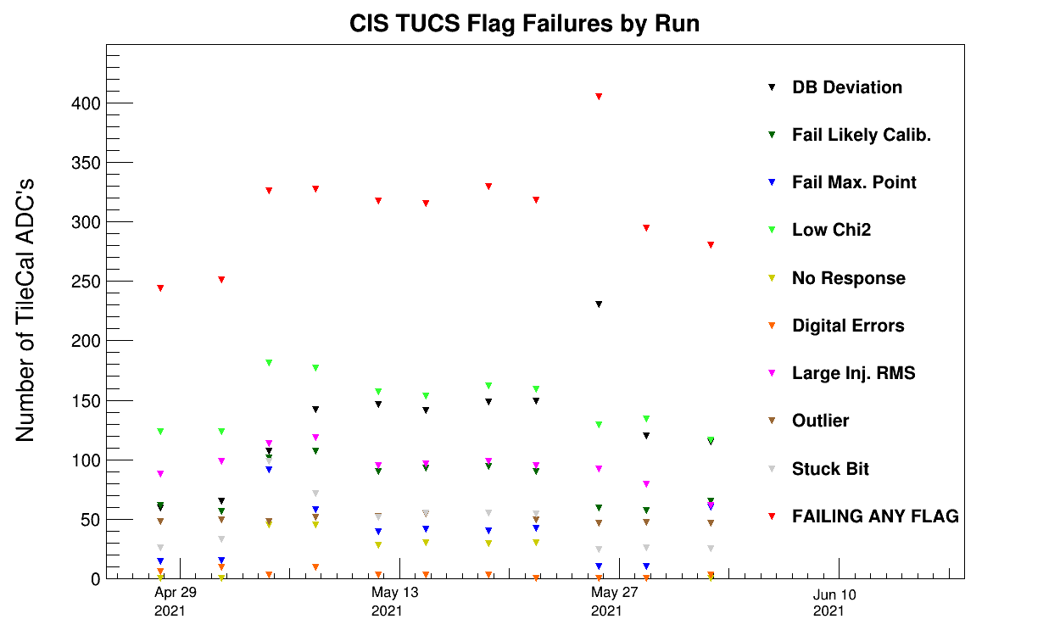
CIS TUCS Quality Flags

Slide 8
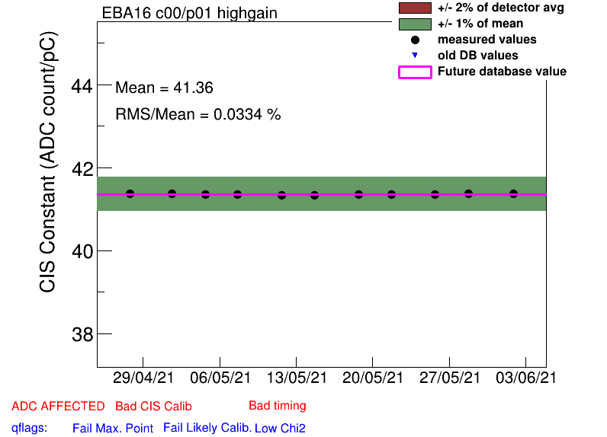
EBA_m16_c00_highgain (DB deviation: -37%)
Bad CIS (half-gain)

Slide 9
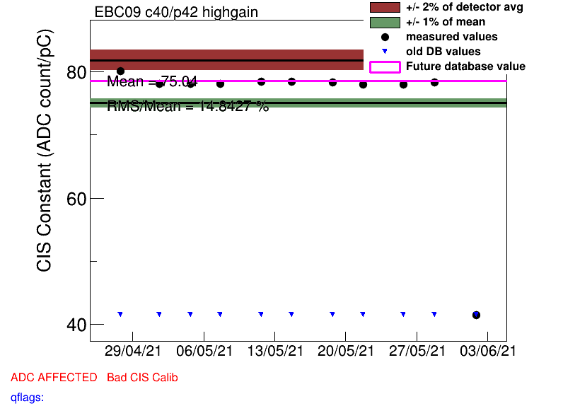
EBC_m09_c40_highgain (DB deviation: 89%)
Constant drop to Bad CIS (half-gain) in June

Slide 10
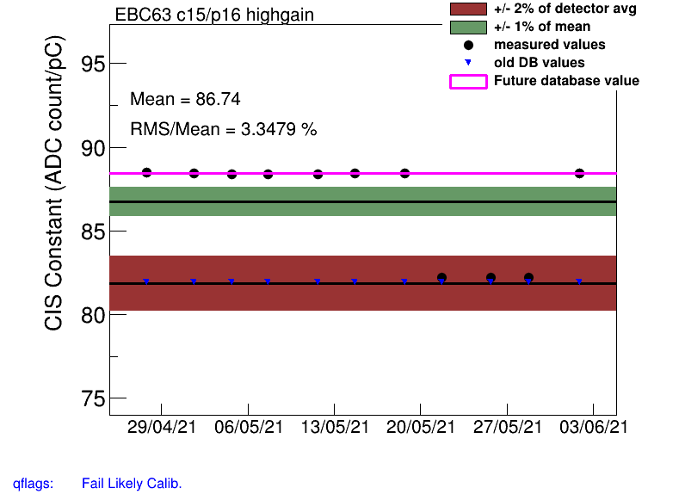
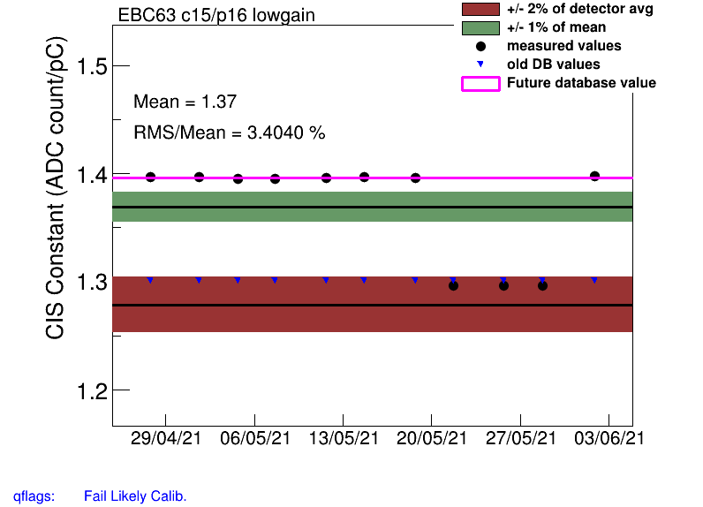
EBC_m63_c15 (high, low) (DB deviation: 7.9, 7.4%)
Constant shift in June - recalibrate

Slide 11
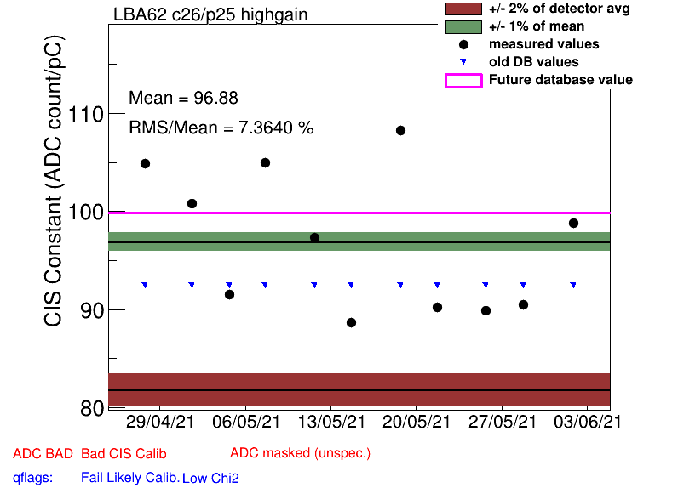
LBA_m62_c26_highgain (DB deviation: 8.1%)
Bad CIS (high scatter)
In DQ report: No Laser response

Slide 12
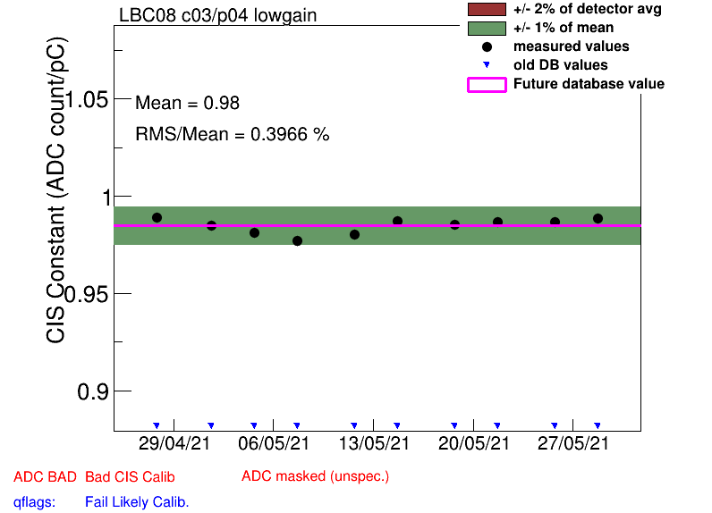
LBC_m08_c03_lowgain (DB deviation: 11.7%)
Low constant, Bad CIS (high scatter)

Slide 13
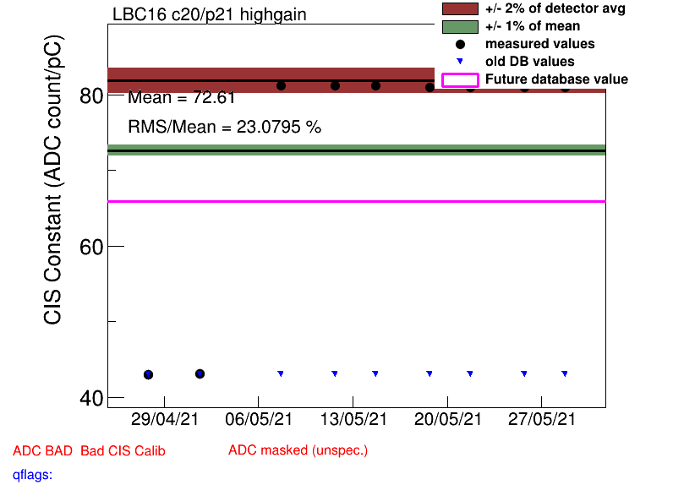
LBC_m16_c20_highgain (DB deviation: 53%)
Constant shift May 06 (maintenance)
In DQ report

Slide 14
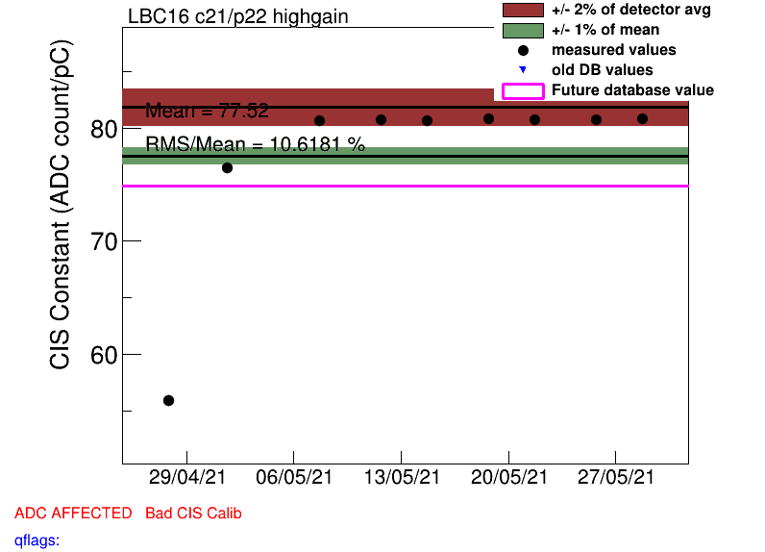
LBC_m16_c21_highgain (DB deviation: 56%)
Constant shift May 06 (maintenance)
In DQ report

Slide 15
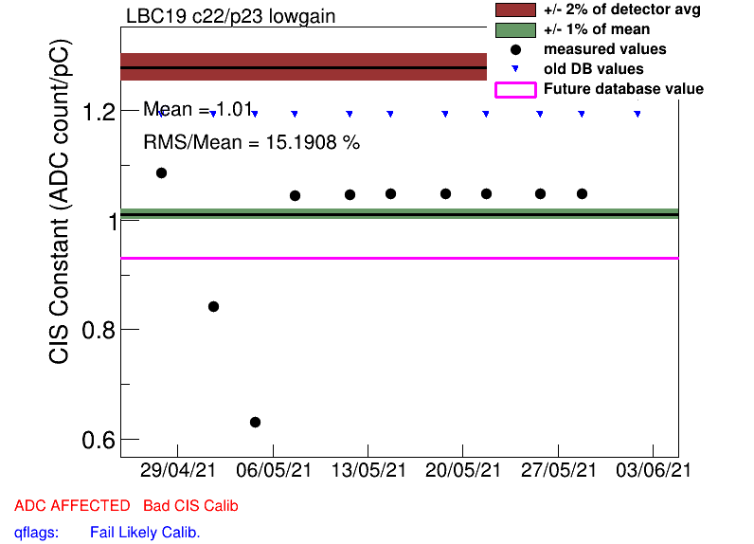
LBC_m19_c22_lowgain (DB deviation: -22%)
Low constant, Bad CIS (high scatter)

Slide 16
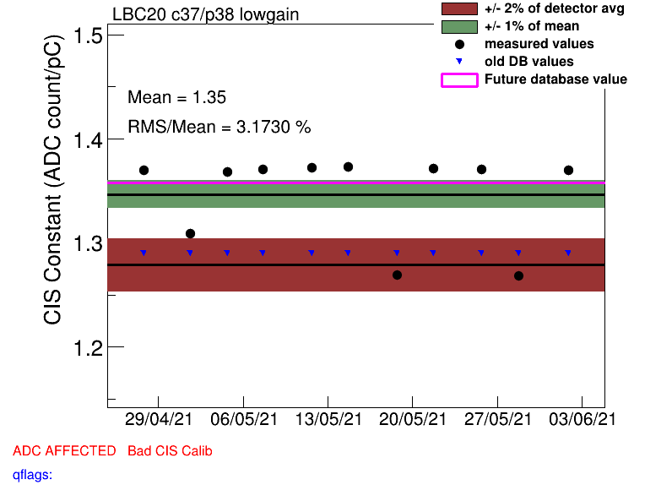
LBC_m20_c37_lowgain (DB deviation: 5.3%)
Bad CIS (high scatter)

Slide 17
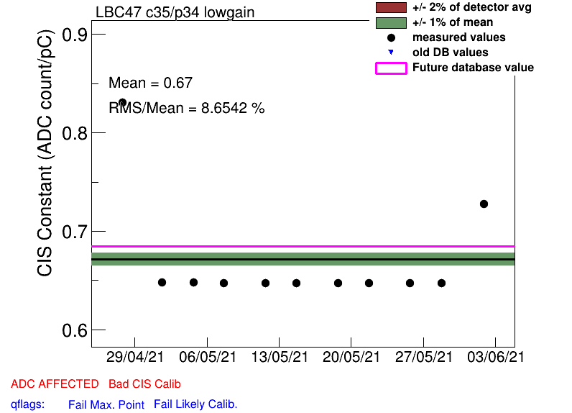
LBC_m47_c35_lowgain (DB deviation: 45%)
Bad CIS (half-gain)
In DQ report: Las timing issue

Slide 18
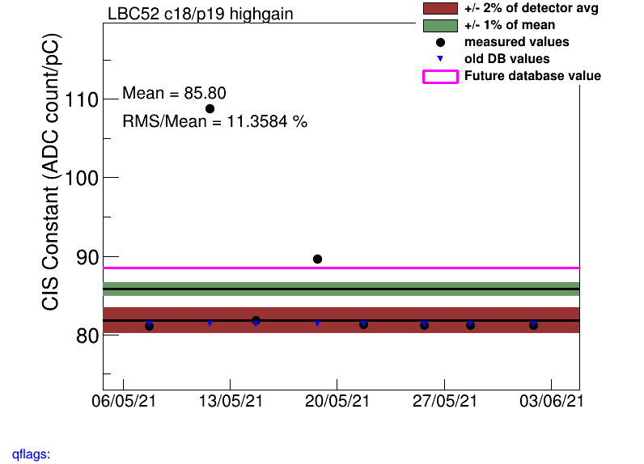
LBC_m52_c18_highgain (DB deviation: 8.9%)
Constant shifts in May - recalibrate

Slide 19
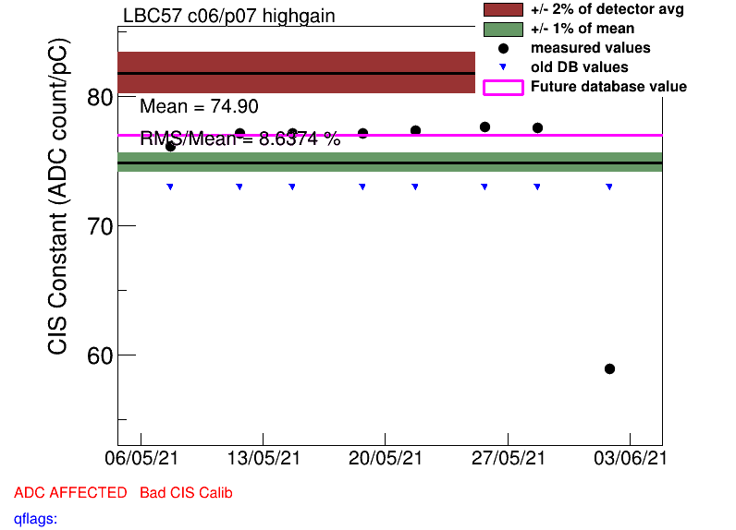
LBC_m57_c06_highgain (DB deviation: 5.5%)
Constant drop in early June

Slide 20
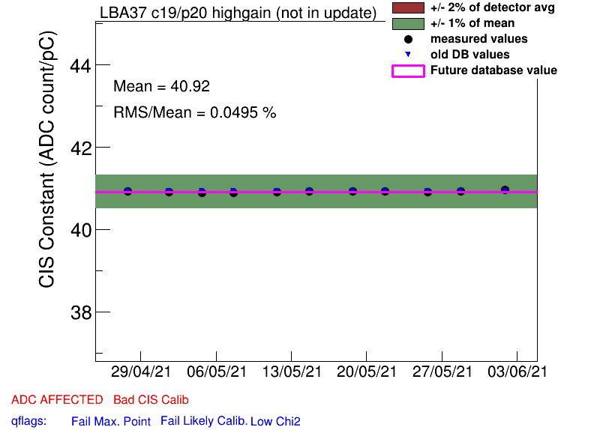
Half-gain channels
EBA_m15_c08_highgain
EBA_m16_c00_highgain
EBA_m36_c15_highgain
EBA_m48_c31_lowgain
EBC_m18_c36_highgain
EBC_m21_c36_lowgain
LBA_m37_c19_highgain
LBC_m47_c35_lowgain

Slide 21
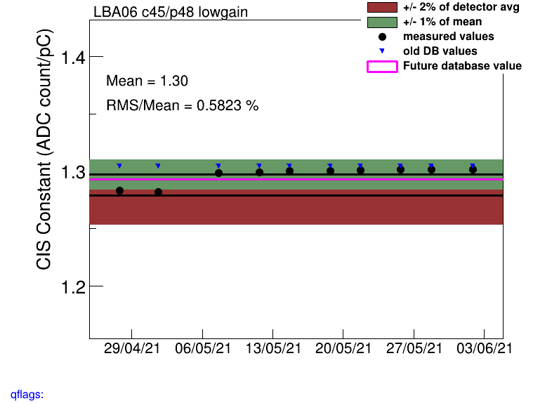
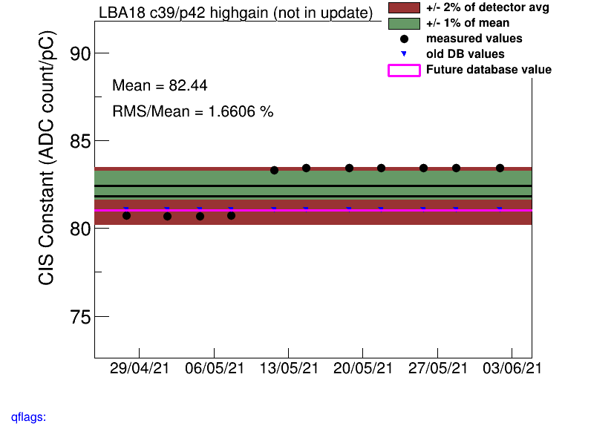
Constant shifts
EBA_m63_c20_lowgain
EBA_m63_c23_lowgain
EBC_m63_c15_highgain, lowgain
LBA_m06_c40_highgain
LBA_m06_c45_highgain, lowgain
LBA_m06_c47_highgain, lowgain
Maintenance May 8
LBA_m18_c06-11, 36-41
Maintenance May 10
LBC_m16_c18-23, 36-41
Maintenance May 6
LBC_m36 all channels
Maintenance May 21
LBC_m37_c40_lowgain
LBC_m37_c45_lowgain
Maintenance May 25
LBC_m52_c18_highgain

Slide 22
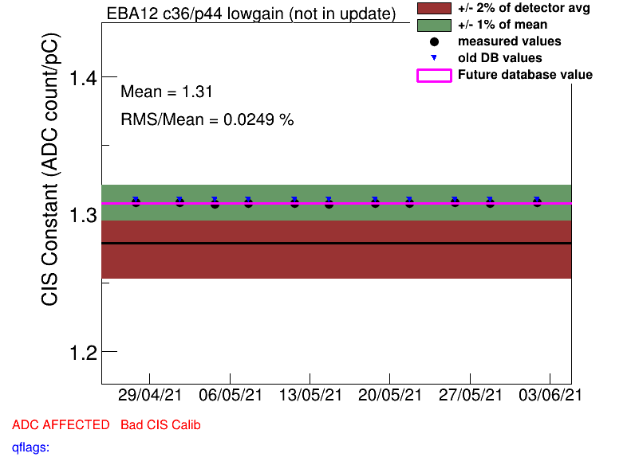
COOL flag changes
Remove Bad CIS (4 stable ADCs):
EBA_m12_c36_lowgain
EBA_m48_c37_highgain
EBC_m15_c16_highgain
LBC_m62_c08_highgain

Slide 23
Helpful links
Primary CIS tools (twiki)
Suspicious channels (this work)
Running a Monthly CIS Update (guide)
April 2021 Update

